Slide 1



Slide 2



01CE0701 – Mobile Computing
Unit - 3
Telecommunication System
(Part 1 – GSM)

Slide 3


Outline
GSM
Introduction
GSM Architecture
Call routing in GSM
PLMN interface
addresses and identifiers
network aspects
frequency allocation
authentication and security
Handoffs Technique

Slide 4

Introduction

Slide 5
GSM vs CDMA
GSM | CDMA
Global System for Mobile communication | Code Division Multiple Access
Technology: FDMA & TDMA | CDMA
Data rate: 42Mbps in HSPA (3G) | Data rate: 3.6Mbps in CDMA
GSM supports transmitting data and voice together | CDMA doesn’t support it
Customer information is stored in SIM card. | Customer information is stored in Handset.
Global market share is 75% | Global market share is 25%
SIM specific. User can use/upgrade to multiple handset | Handset specific
Support International roaming | CDMA doesn’t support this facility

Slide 6
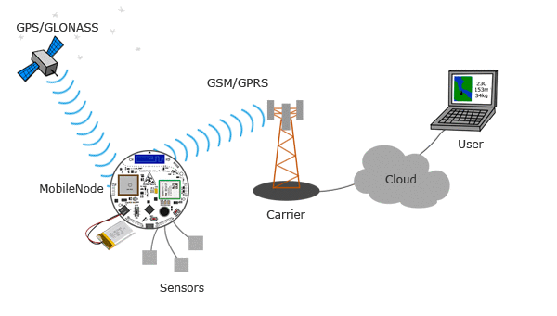
What is GSM?
GSM (Global System for Mobile communications) is an open, digital cellular technology used for transmitting mobile voice and data services.
The concept of GSM emerged from a cell-based mobile radio system at Bell Laboratories in the early 1970s.
The use of harmonised spectrum (uniform allocation of radio frequency bands) across most of the globe, combined with GSM’s international roaming capability, allows travellers to access the same mobile services at home and abroad.
GSM enables individuals to be reached via the same mobile number in up to all countries in the world.

Slide 7
Introduction to GSM
GSM is combination of TDMA (Time Division Multiple Access), FDMA (Frequency Division Multiple Access) and Frequency hopping.
GSM makes use of narrowband Time Division Multiple Access (TDMA) technique for transmitting signals.
GSM was developed using digital technology.
It has an ability to carry 64 kbps to 120 Mbps of data rates.
Presently GSM supports more than one billion mobile subscribers in more than 190 countries throughout the world.
Roaming is the ability to use your GSM phone number in another GSM network.
GSM owns a market share of more than 75% of the world's digital cellular subscribers.

Slide 8
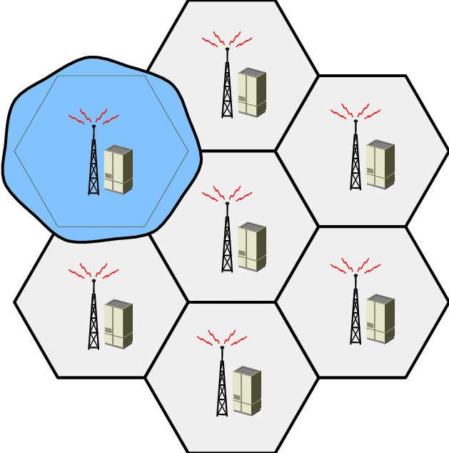
Introduction to GSM
In GSM, geographical area is divided into hexagonal cells whose size depends upon power of transmitter and load on transmitter (number of end user).
At the centre of cell, there is a base station consisting of a transceiver (combination of transmitter and receiver) and an antenna.

Slide 9
Characteristics of GSM
Fully digital system
Security against fraud Enhance Privacy
International roaming
Compatibility with Integrated Services Digital Network (ISDN) and other telephone company services
Support for new services.
Support of Short Message Service (SMS)
Good subjective voice quality.

Slide 10
GSM Services
There are 3 different services in GSM
Tele-services
Bearer or Data Services
Supplementary services

Slide 11
Tele Services
Telecommunication services that enable voice communication via mobile phones.
Offered services
Mobile telephony
Emergency calling

Slide 12
Bearer or Data Services
Include various data services for information transfer between GSM and other networks like PSTN, ISDN etc at rates from 300 to 9600 bps
Short Message Service (SMS)
up to 160 character alphanumeric data transmission to/from the mobile terminal
Multimedia Messaging Services (MMS)
Fax can send in group
Voice mailbox
Electronic mail

Slide 13
Supplementary Services
Call related services
Call Waiting
Notification of an incoming call while call is going on
Call Hold
Put a caller on hold to take another call
Call Barring
Stop - All calls, outgoing calls, or incoming calls
Call Forwarding
Calls can be sent to various numbers defined by the user
Multi Party Call Conferencing
Link multiple calls together

Slide 14
Both GSM and CDMA are 2G standards. The standard for 4G is LTE or (Long Term Evolution of 3g). However, a 4G sim works on a GSM phone.
We can receive calls and messages as usual, but the internet speed will depend on the handset's capability.

Slide 15
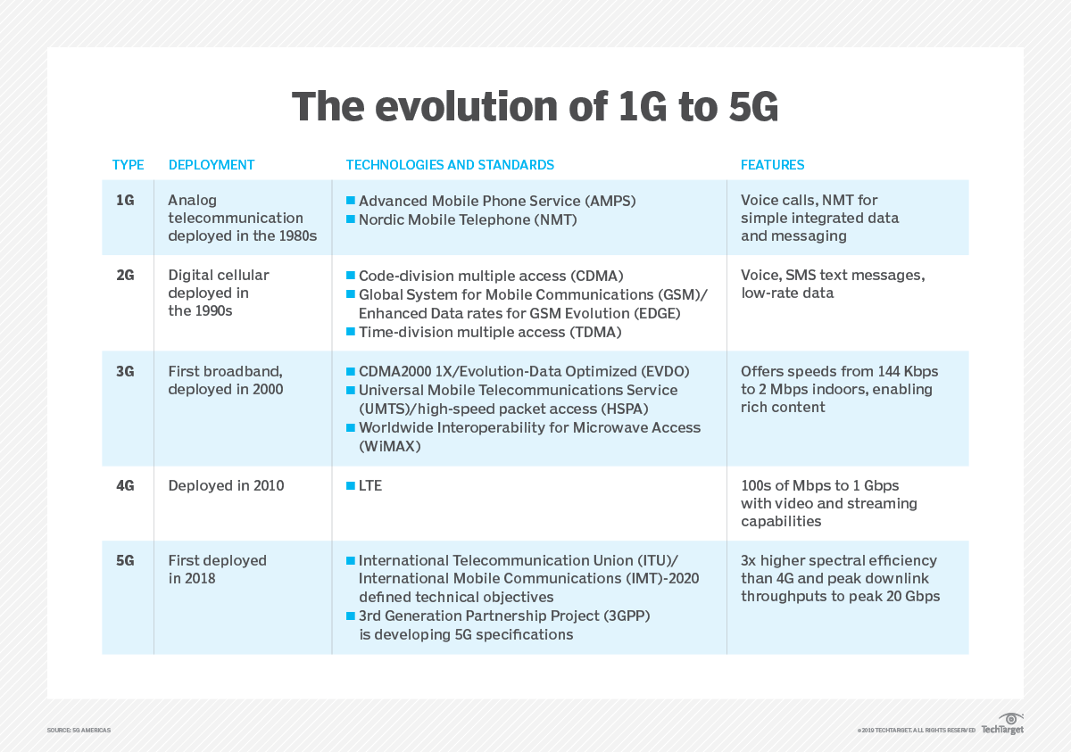

Slide 16
GSM Architecture

Slide 17
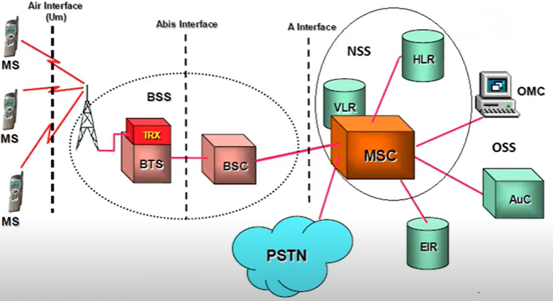
GSM Architecture

Slide 18
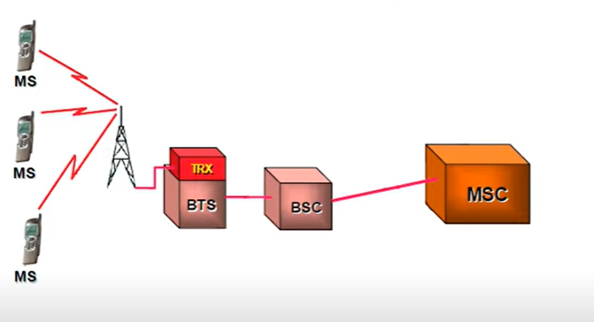
GSM Architecture
Three mobile stations connected to a tower, which is connected to a BTS using TRX then further connected to BSC and then MSC.

Slide 19
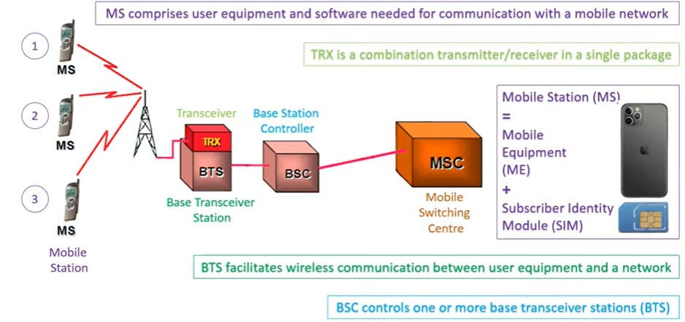
GSM Architecture
MSC is associated with communication switching functions such as call set up, release and routing

Slide 20
GSM Architecture
Multiple mobile stations are connected to a single tower.
Tower connected to BTS, which provide a wireless connection with MS.
Every tower is having BTS.
BSC can have multiple BTS
A BSC can be assumed as a local exchange of your area, which can have multiple towers, and every tower having multiple BTS.
Heart of mobile communication is MSC. Functions are call flow, call tracing, call routing, call recording etc.

Slide 21
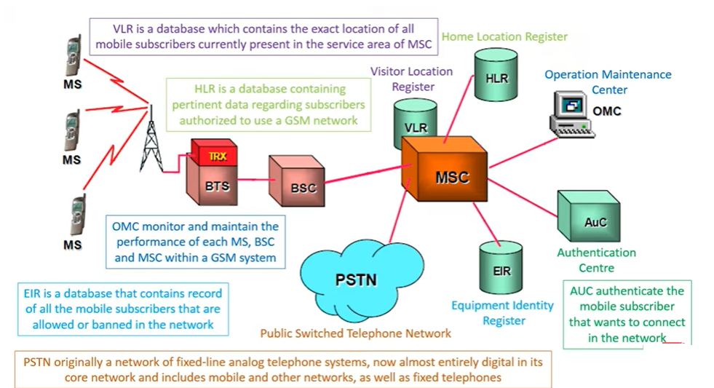
GSM Architecture

Slide 22
GSM Architecture
Components of MSC:
VLR –If you are moving from one state to another then your entry will marked in the database of VLR.
HLR- If you have purchased a SIM from a specific location then your entry will be marked on that HLR, contains id proofs, plan you are taking etc.
PSTN-Land line system.

Slide 23
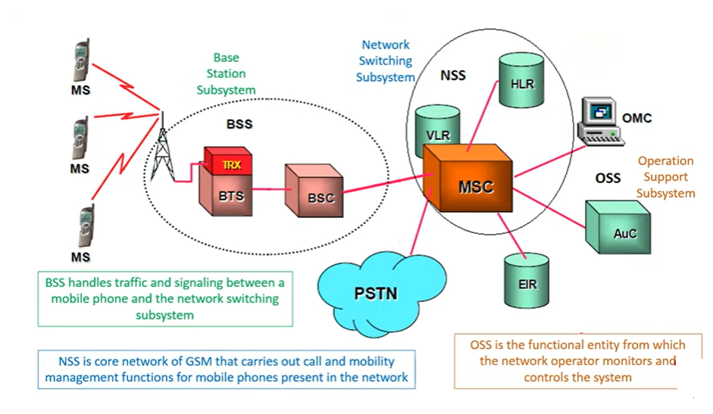
GSM Architecture
OMC is a part of OSS.

Slide 24
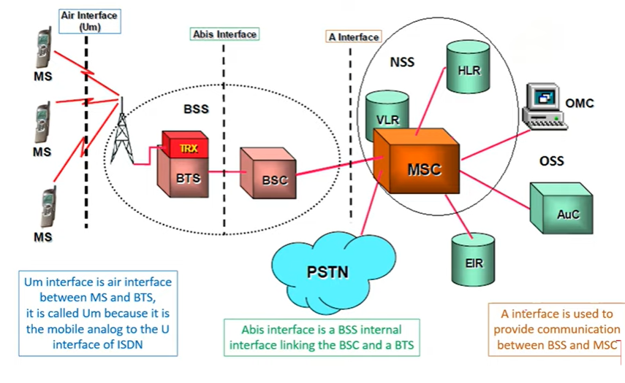
GSM Architecture
Interfaces
Notes:
The U interface or U reference point is a Basic Rate Interface in the local loop of an Integrated Services Digital Network, connecting the network terminator on the customer's premises to the line termination in the carrier's local exchange, in other words providing the connection from subscriber to central office
The Abis interface consists of the protocols spoken between the BSC (Base Station Controller) and BTS (Base Transceiver Station).
A interface The A interface is used to provide communication between the BSS and the MSC. The interface carries information to enable the channels, timeslots and the like to be allocated to the mobile equipments being serviced by the BSSs.

Slide 25
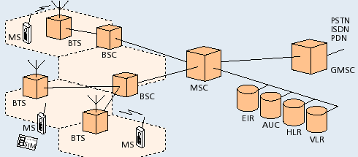
GSM Architecture-Summary
AUC | Authentication center
HLR | Home Location Register
PSTN | Public Switching Telephone Network
BSC | Base station controller
ISDN | Integrated System Digital Network
VLR | Visitor Location Register
BTS | Base trans-receiver system
MS | Mobile station
EIR | Equipment Identity Register
MSC | Mobile Switching Centre
GMSC | Gateway MSC
PDN | Packet Data Network

Slide 26
GSM Architecture
Operation &
Maintenance
Centre
OMC
ISC
PLMN & INTERNET
BSC
BTS
GMSC
PSTN
ISDN
PDN
MSC
GMSC – Gateway Mobile Switching Centre
ISC – International Switching Centre
PLMN – Public Land Mobile Network
VLR
BSC
BTS
HLR
AUC
BTS
EIR

Slide 27
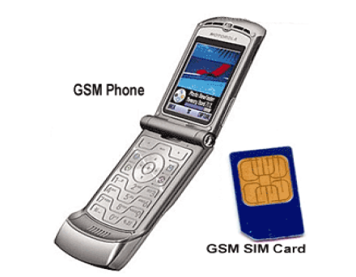
GSM Architecture: Mobile Station (MS)

Slide 28
GSM Architecture: Mobile Station
MS consists of following two components
Mobile Equipment (ME)
Mobile Subscriber Identity Module (SIM)
Removable plastic card
Stores Network Specific Data such as list of carrier frequencies and current LAI.
Stores International Mobile Subscriber Identity (IMSI) + ISDN
Stores Personal Identification Number (PIN) & Authentication Keys.
Also stores short messages, charging information, telephone book etc.
Allows separation of user mobility from equipment mobility

Slide 29
GSM Architecture: In Detail

Slide 30
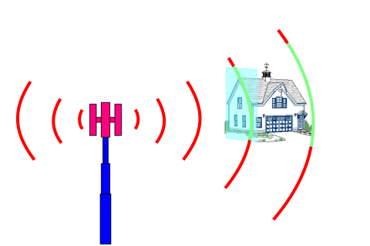
GSM Architecture: Base Transceiver Station (BTS)
One per cell
Consists of high speed transmitter and receiver
Its transmit power decides size of cell
Function of BTS
Provides two channels
Signalling and Data Channel
Performs error protection coding for the radio channel

Slide 31
GSM Architecture: Base Station Controller (BSC)
Controls multiple BTS
Functions of BSC
Performs radio resource management
Assigns and releases frequencies and time slots for all the MSs in its area
Reallocation of frequencies among cells
Hand over protocol is executed here
Time and frequency synchronization signals to BTSs
Time Delay Measurement and notification of an MS to BTS
Power Management of BTS and MS

Slide 32
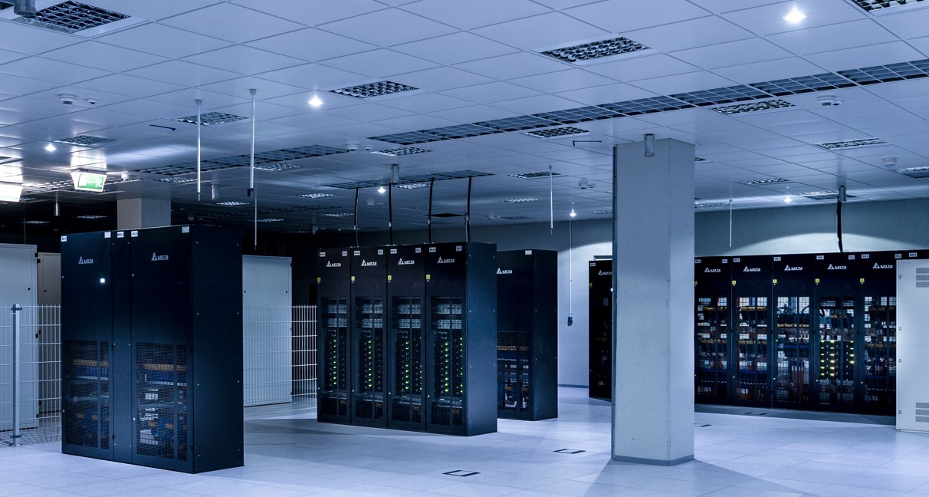
GSM Architecture: Mobile Switching Centre (MSC)
Switching node of a PLMN(Public Land Mobile Network)
Task of MSC
Registration
Authentication
Location updating
Handovers
Call routing
Mobility of subscribers
Location registration of subscriber
There can be several MSCs in a PLMN

Slide 33
GSM Architecture: Mobile Switching Centre (MSC)
What is a PLMN?
PLMN stands for Public Land Mobile Network and is a mobile operator’s cellular network in a specific country.
A public land mobile network is a combination of wireless communication services offered by a specific operator in a specific country.
Each PLMN has a unique PLMN code that combines an MCC (Mobile Country Code) and the operators’ MNC (Mobile Network Code).
When you receive a SIM from an operator, it will often have PLMN lists on it. These lists are a way to prioritize networks you would like to use on the SIM.
Typically, PLMN lists are based on commercial agreements. So, for example, an operator will have contracts in various countries so your SIM can connect to specific networks when you roam outside their network.

Slide 34
GSM Architecture: Gateway MSC (GMSC)
Connects mobile network to a fixed network
Entry point to a PLMN
Usually one per PLMN
Request routing information from the HLR and routes the connection to the local MSC

Slide 35
GSM Architecture: Home Location Register (HLR)
For all users registered with the network, HLR keeps user profile.
Logically only one HLR per PLMN
Persistent storage of user data
MSCs exchange information with HLR
When MS registers with a new GMSC, the HLR sends the user profile to the new MSC
Includes information like
Current location of user
Authentication data
Service provisioning information

Slide 36
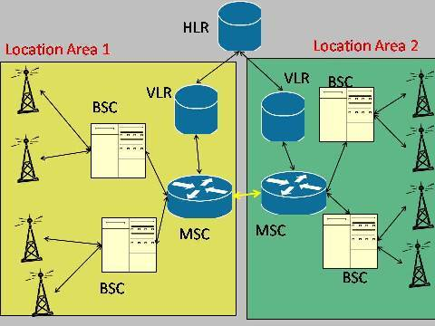
GSM Architecture: Visitor Location Register (VLR)
VLR is responsible for a group of location areas, typically associated with an MSC
Contains temporary information needed for call control typically copied from HLR.
When subscriber enters a new MSC, VLR associated with that MSC requests user info from corresponding HLR

Slide 37
GSM Architecture: AUC and EIR
AUC: Authentication Center
Accessed by HLR to authenticate a user for service
Contains authentication and encryption keys for subscribers
EIR: Equipment Identity Register
Allows stolen or fraudulent mobile stations to be identified

Slide 38
GSM System Hierarchy
Administrative Region
Public Land Mobile Network(PLMN)/ GSM Administrative Region
Mobile Switching Centre (MSC) Region
Registration, Authentication, location updating, handovers and call routing
Location Area
Location Area (LA)
Base Station Controller
Base Station Controller (BSC)
One LA consist of many cell groups & each cell group is assigned to one BSC
Cell
Cell
BSC
Location Area
One BSC can belong to different LA’s
MSC Region

Slide 39
GSM Entities
Mobile Station (MS)
Mobile Equipment (ME)
Subscriber Identity Module (SIM)
Base Station Subsystem (BSS)
Base Transceiver Station (BTS)
Base Station Controller (BSC)
Network and Switching Subsystem (NSS)
Mobile Switching Center (MSC)
Home Location Register (HLR)
Visitor Location Register (VLR)
Equipment Identity Register (EIR)
Authentication Center (AUC)
Operation and Support Subsystem (OSS)
Operation and Maintenance Center (OMC)

Slide 40
GSM Entities-Diagramatic Representation
OSS
OMC
BSS
ISC
PLMN & INTERNET
BSC
BTS
GMSC
PSTN
ISDN
PDN
MSC
VLR
BSC
BTS
HLR
AUC
BTS
NSS
EIR

Slide 41
GSM Addresses and Identifiers

Slide 42
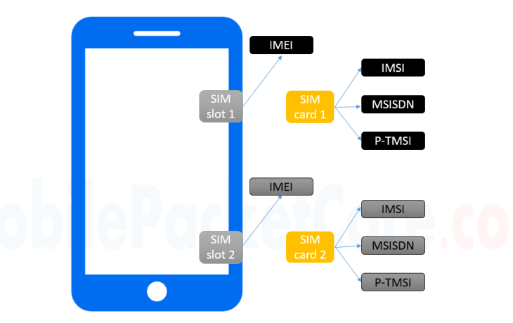
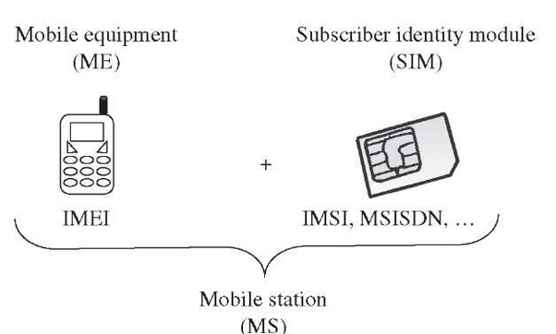
GSM Addresses and Identifiers

Slide 43
GSM Addresses and Identifiers: IMSI
IMSI: International Mobile Subscriber Identity
IMSI identifies registered smartphone users
A working SIM card has a valid IMSI
Each IMSI consists of three parts:
Mobile Subscriber Identification Number (MSIN)
identifies the subscriber in his or her mobile network.
Mobile Country Code (MCC)
It gets 3 decimal places and identifies the country of mobile device owner.
Mobile Network Code (MNC)
It identifies your carrier network
Maximum 15 digit
3 digits
2-3 digits
10 digits
MCC
MNC
MSIN
National MSI
IMSI

Slide 44
GSM Addresses and Identifiers: IMEI
IMEI: International Mobile Equipment Identity
15-digit number to uniquely identify a mobile phone device.
Every mobile equipment in this world has a unique identifier which is called IMEI.
IMEI allocated by the equipment manufacturer and registered by the network operator in the Equipment Identity Register (EIR).

Slide 45
GSM Addresses and Identifiers: MSISDN
Mobile Subscriber ISDN Number
MSISDN is primary key to the HLR record.
The MSISDN number is the real telephone number as is known to the external world.
MSISDN number is public information whereas IMSI is private to the operator.
IMSI is assigned a total of three numbers: one for the voice call, one for a fax call and another for the data call.
MSISDN follows the international ISDN (Integrated Systems Data Network) numbering plan.
3 digits
2-3 digits
Max. 10 digits
CC
NDC
SN
MSISDN
Country Code - CC
National Destination Code - NDC
Subscriber Number - SN

Slide 46
GSM Addresses and Identifiers: LAI
LAI: Location Area Identifier.
Each LA in a PLMN has own identifier called Location Area Identifier (LAI) which is structured hierarchically and unique.
Example: 502-20-60001
3 digits
2 digits
1 to 65536
MCC
MNC
LAC
LAI
Mobile Country Code - MCC
Mobile Network Code - MNC
Location Area Code - LAC

Slide 47
GSM Addresses and Identifiers: MSRN
MSRN: Mobile Station Roaming Number.
When a subscriber is roaming in another network, a temporary ISDN number assigned to the subscriber called MSRN.
MSRN assigned by the local VLR in charge of the mobile station and follows the structure of MSISDN.

Slide 48
GSM Addresses and Identifiers
Temporary Mobile Subscriber Identity (TMSI): TMSI is a temporary identifier assigned by the serving VLR used in place of the IMSI for identification and addressing of the mobile station.
Together with the current location area, a TMSI allows a subscriber to identified uniquely.
Local Mobile Subscriber Identity (LMSI): LMSI assigned by the VLR and stored in the HLR and used as a searching key for faster database access within the VLR.
Cell Identifier: Within an LA, every cell has a unique Cell Identifier (CI) together with an LAI, a cell can be identified uniquely through Global Cell Identity (LAI & CI).

Slide 49
GSM Addresses and Identifiers (Summery)
IMSI | International Mobile Subscriber Identity
IMEI | International Mobile Equipment Identity
MSISDN | Mobile Subscriber ISDN
LAI | Location Area Identifier
MSRN | Mobile Station Roaming Number
TMSI | Temporary Mobile Subscriber Identity
LMSI | Local Mobile Subscriber Identity

Slide 50
Call Routing in GSM

Slide 51
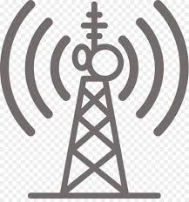




HLR
VLR
MSC
HLR
VLR
AUC
EIR
MS
AUC
EIR
MSC
BTS
MS
BSC
MS
BTS
MS
MS
MS
BTS
BTS
MS
MS
MS
MS
GMSC
BSC
BTS
BTS
MS
MS
BSC
MS
MS
BTS
BTS
PSTN
MS
MS
MS
BTS
MS
Call Routing in GSM

Slide 52
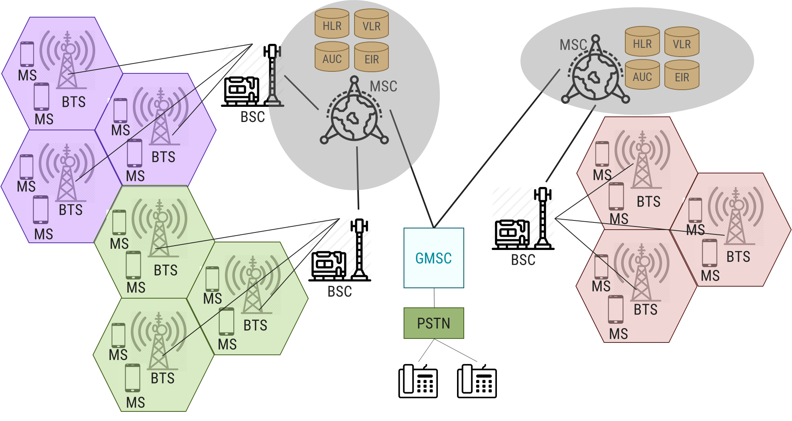
Call routing in GSM: Mobile Phone to PSTN
Mobile phone subscriber will dial a number on PSTN network
To identify the communicating network the MSC will receive the message of a call request through BTS and BSC respectively.
The MSC checks if the MS is authorized to access the destination network. If YES, then service of MS is activated, else the service will be denied.
MSC will ask the BSC to allocate a traffic channel (radio channel + time slot)
The BSC will allocates the traffic channel and pass the information to PSTN telephone.

Slide 53
Call routing in GSM: Mobile Phone to PSTN
The called party answers the call and the conversation takes place.
The MS keeps on taking measurements of the radio channels in the present cell and the neighbouring cells and passes the information to the BSC.
The BSC decides if a handover is required.
If so, a new traffic channel is allocated to the mobile station and the handover takes place.
If handover is not required, the mobile station continues to transmit in the same frequency.

Slide 54
Call Routing: Mobile Originated

Slide 55
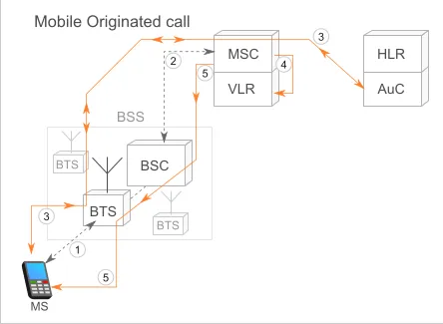
Mobile Originated Call
Step-1 | To initiate a call, the MS request for radio resource allocation to the BSS, which mediates further connection to the Mobile Switching Center (MSC). The BSS assigns the MS a channel with a given frequency and time slot.
Step-2 | BSS initiate the connection to the MSC.
Step-3 | Now as MS had connected to the network, the subscriber needs to be authenticated. As IMSI number is stored in MS SIM card, AUC will verify subscriber’s identity. Thus, MS and MSC are now connected. MSC initiates a ciphering procedure which is transmitted to the BTS, which in turn forwards the message to the MS. it will start the ciphered transmission of information, finalizing the encryption procedure.
Step-4 | MSC verifies that the requested service is allowed for the subscriber. This information is available in VLR. Once the VLR confirms the service requested by the originating MS, the MSC starts the call setup.

Slide 56
Mobile Originated Call
Step-5 | MSC allocates a voice channel between the MSC and the BSS. The MSC routes the call to the dialed number. When the call is received in the PSTN, the MSC is notified that the called subscriber is being alerted, at which point the originating MS receives a ring notification.
Step-6 | To disconnect the call by either party, a disconnect message is sent to the MSC, which releases the communication channels created with the PSTN and the BSS

Slide 57
Call Routing: PSTN Originated

Slide 58
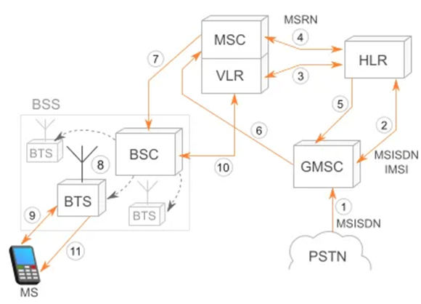
PSTN Originated Call
Step-1 | When a call is placed from the PSTN, the PSTN uses the information in the phone number (country and if available, operator) to locate GMSC leading to the MSC where the subscriber is registered.
Step-2 | GMSC can request information about the subscriber’s core network and current location by interrogating the HLR.
Step-3 | HLR constantly updates locations of the MS stored in the VLRs of the networks the MS visits. In the HLR, the subscriber MSISDN (phone number) is associated with the IMSI number of the SIM card, which was used to authenticate the subscriber in the visited network as they registered. HLR is aware of the visited MSC/VLR of the MS at a given time.
Step-4 | In order for the GMSC to pass the call to the MSC, the HLR asks a temporary roaming phone number(MSRN) from the MSC. (Mobile Station Roaming Number – MSRN).
Notes:
The Gateway Mobile Switching Center (GMSC) is a type of Mobile Switching Center (MSC) that is used to route calls outside the mobile network. Mobile Switching Center Servers (MSC-S) provide control of high-capacity switching in mobile circuit core networks for operators to control services and switching.

Slide 59
PSTN Originated Call
Step-5 | MSRN is sent back from the HLR to the GMSC.
Step-6 | GMSC forward the call to the MSC using the assigned MSRN.
Step-7 | MSC pages all the BSCs in the area that it serves.
Step-8 | Then BSC assigned page to the BTSs.
Step-9 | Called MS responds to the paging from the BTS, asking to establish a radio channel to the BTS.
Step-10 | Response is forwarded to the MSC, which, once notified, authenticates the MS and initiates the ciphering of the call
Step-11 | MSC sends back to the radio network the call confirmation message, the called MS starts to ring.
Step-12 | Then, MSC notifies the GMSC, which notifies the PSTN that the destination number is being alerted.

Slide 60
PLMN Interface

Slide 61
PLMN Interface
HLR
SP
SP
EIR
SS#7 Network
&
Leased Line
AUC
SP
MSC
SP
SP
SP
GMSC
PSTN
ISD
PDN
VLR
MSC
VLR
VLR
BSC
Signaling Data
BTS
User data
BTS

Slide 62
PLMN Interface
PLMN: Public Land Mobile Network
A basic configuration of a GSM network contains a central HLR and a central VLR, where
HLR contains all security, provisioning and subscriber related information
VLR stores the location information and other transient data.
MSC needs subscriber parameter for successful call set-up.
Any data related to user call (connection establishment, teardown, etc.) processed with the SS7 protocol for signaling.
For mobile specific signaling, a protocol stack called MAP (Mobile Application Part) used over the SS7 network which does all database transactions and handover/roaming transactions between the MSC.
MSC uses registers known as SP – Signaling Point.
SS7 is also widely used for signaling between wireless networks and the PSTN.
In GSM networks, SS7 is also used for signaling between Base Station Controllers (BSC) and the Mobile Switching Center (MSC).

Slide 63
GSM Handoff

Slide 64
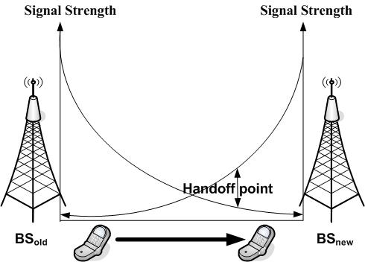
Handoff
In cellular communications, the terms handover or handoff refers to the process of transferring ongoing call or data connectivity from old Base Station to new Base Station.
When a mobile moves into the different cell while the conversation is in progress then the MSC (Mobile Switching Centre) will transfer the call to a new channel belonging to the new Base Station.
When a mobile user A moves from one cell to another cell then BTS 1 signal strength loses for the mobile User A and the signal strength of BTS 2 increases and thus ongoing calls or data connectivity for mobile user goes on without interrupting.

Slide 65
Handoff
Situations for triggering Handoff
Handoffs are triggered in any of the following situations −
If a subscriber who is in a call or a data session moves out of coverage of one cell and enters coverage area of another cell, a handoff is triggered for a continuum of service. The tasks that were being performed by the first cell are delineating to the latter cell.
Each cell has a pre-defined capacity, i.e. it can handle only a specific number of subscribers. If the number of users using a particular cell reaches its maximum capacity, then a handoff occurs. Some of the calls are transferred to adjoining cells, provided that the subscriber is in the overlapping coverage area of both the cells.
Cells are often sub-divided into microcells. A handoff may occur when there is a transfer of duties from the large cell to the smaller cell and vice versa. For example, there is a traveling user moving within the jurisdiction of a large cell. If the traveler stops, then the jurisdiction is transferred to a microcell to relieve the load on the large cell.
Handoffs may also occur when there is an interference of calls using the same frequency for communication.

Slide 66
Why Handoff?
Two Reasons
When The Radio Signal’s quality and power decreases to necessary scores, the connection deliver to more powerful cell.
When the Traffic Capacity approaches to maximum, the connection deliver to less density of traffic cell.

Slide 67
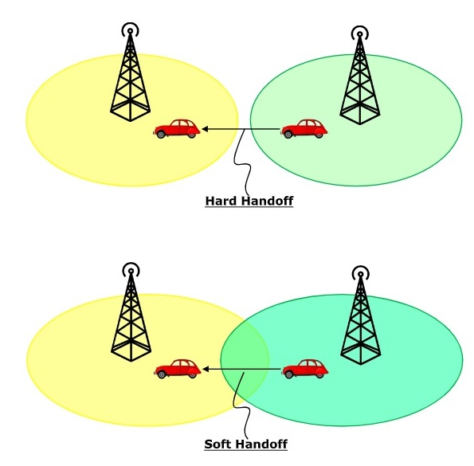
Handoff Types: Soft Handoff vs Hard Handoff
Hard Handoff | Soft Handoff
Break in the connection occurs while switching from one cell to another. | Break in the connection will not occur due to overlapping cells.
The radio links from the mobile station to the existing cell is broken before establishing a link with the next cell. | In soft handoff, at least one of the links is kept when radio links are added and removed to the mobile station.
It is a “break before make” policy. | It is a “make before break” policy.

Slide 68
Types of Handover/Handoff
Four types of handover in GSM:
OMC
ISC
PLMN & INTERNET
BSC
BTS
GMSC
PSTN
ISDN
PDN
MSC
MSC
BSC
BTS
VLR
HLR
BTS
AUC
EIR
3. Inter-BSC handover
4. Inter-MSC handover
2. Inter-cell handover
1. Intra - Cell Handover

Slide 69
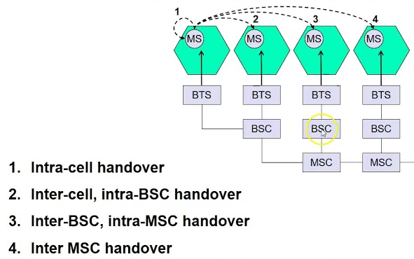
Handoff Types

Slide 70
Network Aspect in GSM

Slide 71
Network Aspect in GSM: Signaling Protocol Structure
Transmission of voice and data over the radio link is only a part of the function of a cellular mobile network. A GSM mobile can seamlessly roam nationally and internationally.
This requires that registration, authentication, call routing and location updating functions are standardized across GSM networks. The geographical area covered by a network is divided into cells of small radius.
When a call is in progress and the user is on the move, there will be a handover mechanism from one cell to another. This is like a relay race where one athlete passes on the baton to another.
Though both roaming and handover functions are the basic characteristic of mobility, there is a difference between these functions.
These functions are performed by the Network Subsystem, mainly using the Mobile Application Part (MAP) built on top of the Signalling System # 7 (SS7)

Slide 72
Network Aspect in GSM: Signaling Protocol Structure

Slide 73
Network Aspect in GSM: Signaling Protocol Structure
GSM architecture is a layered model that is designed to allow communications between two different systems.
The lower layers assure the services of the upper-layer protocols.
Each layer passes suitable notifications to ensure the transmitted data has been formatted, transmitted, and received accurately.
Um
A
CM MM RR
LAPDm
TDMA
CM MM BSSMAP
SCCP
MTP
GSM
Layer 3
Abis
RR
LAPDm
TDMA
BSSMAP
SCCP
MTP
Layer 2
Layer 1
Mobile Station
BTS
BSC
MSC

Slide 74
Network Aspect in GSM: Signaling Protocol Structure
GSM signalling protocol is categorized into three general layers:
Layer 1 - physical layer: It uses the channel structures over the air interface.
Layer 2 - The data-link layer: Across the Um interface, the data-link layer is a modified version of the Link access protocol for the D channel (LAP-D) protocol used in ISDN, called Link access protocol on the Dm channel (LAP-Dm). Across the A interface, the Message Transfer Part (MTP), Layer 2 of SS7 is used.
Um
A
CM MM RR
LAPDm
TDMA
CM MM BSSMAP
SCCP
MTP
GSM
Layer 3
Abis
RR
LAPDm
TDMA
BSSMAP
SCCP
MTP
Layer 2
Layer 1
Mobile Station
BTS
BSC
MSC

Slide 75
Network Aspect in GSM: Signaling Protocol Structure
The GSM signalling protocol is categorized into three general layers:
Layer 3 : GSM signalling protocol’s third layer is divided into three sublayers:
Radio Resource Management (RR): It controls the set-up, maintenance, and termination of radio channels, including handovers.
Mobility Management (MM):It manages the location updating and registration procedures as well as security and authentication.
Connection Management (CM): It handles general call control and manages Supplementary Services and the Short Message Service(SMS).
Um
A
CM MM RR
LAPDm
TDMA
CM MM BSSMAP
SCCP
MTP
GSM
Layer 3
Abis
RR
LAPDm
TDMA
BSSMAP
SCCP
MTP
Layer 2
Layer 1
Mobile Station
BTS
BSC
MSC

Slide 76
Network Aspect in GSM: Signaling Protocol Structure
MS to BTS Protocols
RR layer :
Manages a link, both radio and fixed, between the MS and the MSC
Manages the RR-session, the time when a mobile is in a dedicated mode, and the radio channels including the allocation of dedicated channels.
MM layer: Stacked above the RR layer
Handles the functions that arise from the mobility of the subscriber
Authentication and security aspects
Location management
A
Um
CM MM RR
LAPDm
TDMA
CM MM BSSMAP
SCCP
MTP
GSM
Layer 3
Abis
RR
LAPDm
TDMA
BSSMAP
SCCP
MTP
Layer 2
Layer 1
Mobile Station
BTS
BSC
MSC

Slide 77
Network Aspect in GSM: Signaling Protocol Structure
MS Protocols
CM Layer: Call Management(CM) is topmost layer of the GSM protocol stack
Responsible for Call Control, Supplementary Service Management, and Short Message Service Management.
Handles call establishment, selection of the type of service (including alternating between services during a call), and call release.
LAPDm: Link Access Protocol on Channel D
A
LAPDm is a data link layer protocol used in GSM cellular networks.
It is used in the radio link between the cellular network and the subscriber handset.
CM MM RR
LAPDm
TDMA
Um
CM MM BSSMAP
SCCP
MTP
GSM
Layer 3
Abis
RR
LAPDm
TDMA
BSSMAP
SCCP
MTP
Layer 2
Layer 1
Mobile Station
BTS
BSC
MSC

Slide 78
Network Aspect in GSM: Signaling Protocol Structure
Um interface
The Um interface is the air interface of the GSM mobile telephone standard.
It is the interface between the mobile station (MS) and the Base transceiver station (BTS).
It is known as Um because it is the mobile analog to the U interface of ISDN.
Um can also support GPRS packet-oriented communication.
Um
A
CM MM RR
LAPDm
TDMA
CM MM BSSMAP
SCCP
MTP
GSM
Layer 3
Abis
RR
LAPDm
TDMA
BSSMAP
SCCP
MTP
Layer 2
Layer 1
Mobile Station
BTS
BSC
MSC

Slide 79
Network Aspect in GSM: Signaling Protocol Structure
BSC Protocols: Uses a different set of protocols after receiving the data from BTS.
Abis interface: Used between the BTS and BSC.
Allows control of the radio equipment and radio frequency allocation in the BTS.
BSSMAP: Base Station System Management Application Part
Designed for signalling over the A interface
Supports both connectionless and connection-oriented services provided by the SCCP
Supports message transfer between the MSC and the MS
Um
A
CM MM RR
LAPDm
TDMA
CM MM BSSMAP
SCCP
MTP
GSM
Layer 3
Abis
RR
LAPDm
TDMA
BSSMAP
SCCP
MTP
Layer 2
Layer 1
Mobile Station
BTS
BSC
MSC

Slide 80
Network Aspect in GSM: Signaling Protocol Structure
BSC Protocols: Uses a different set of protocols after receiving the data from BTS.
SCCP: Signalling Connection Control Part (SSCP) is a network layer protocol
Provides extended routing, flow control, segmentation, connection-orientation, and error correction facilities in Signaling System 7 (SS7) telecommunications networks.
SCCP relies on the services of MTP for basic routing and error detection.
MTP: Message Transfer Part
Part of the Signalling System 7 (SS7) used for communication in Public Switched Telephone Networks (PSTN).
MTP is responsible for reliable, unduplicated and in-sequence transport of SS7 messages between communication partners.
Um
A
CM MM RR
LAPDm
TDMA
CM MM BSSMAP
SCCP
MTP
GSM
Layer 3
Abis
RR
LAPDm
TDMA
BSSMAP
SCCP
MTP
Layer 2
Layer 1
Mobile Station
BTS
BSC
MSC

Slide 81
Network Aspect in GSM: Signaling Protocol Structure
MSC Protocols
A interface:
Used to provide communication between the BSC and the MSC.
The interface carries information to enable the channels, timeslots and the like to be allocated to the mobile equipment's being serviced by the BSSs.
At the MSC, starting from the BSC, the information is mapped across the A interface to the MTP Layers 1 through 3.
Location registers are included in the MSC databases to assist in the role of determining how and whether connections are to be made to roaming users.
A
CM MM RR
LAPDm
TDMA
Um
CM MM BSSMAP
SCCP
MTP
GSM
Layer 3
Abis
RR
LAPDm
TDMA
BSSMAP
SCCP
MTP
Layer 2
Layer 1
Mobile Station
BTS
BSC
MSC

Slide 82
GSM Frequency Allocation

Slide 83
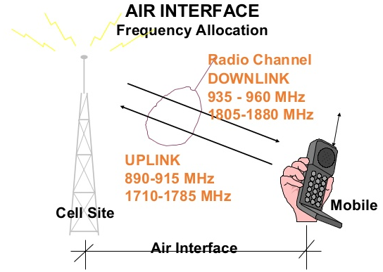
GSM Frequency Allocation
Uplink: is a frequency transmission that links mobile handset to base station
Downlink: is a frequency transmission that links base station to mobile handset
There are 4 major GSM frequency bands
850 MHz
900 MHz
1800 MHz
1900 MHz
Allocation of band
Country | Frequency Band
United States | 850 MHz and 1900 MHz
Rest of the world (Europe, Middle East, Africa, Asia) | 900 MHz and 1800 MHz

Slide 84
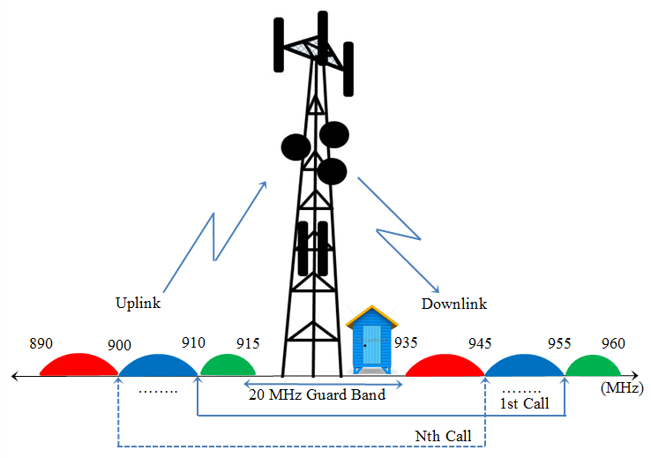
GSM Bands in India
Each way the bandwidth for the GSM system is 25 MHz which provides 125 carriers uplink/downlink each having a bandwidth of 200 kHz.
For Uplink: 900 MHz of frequency is allocated.
Range: 890-915 MHz
For Downlink: 900 MHz of frequency is allocated.
Range: 935-960 MHz

Slide 85
Authentication and Security
Authentication involves two functional entities:
SIM card in the mobile phone
Authentication Center (AUC)
For authentication; different algorithms used:
MS algorithm A3
Voice Privacy key algorithm A8
Strong over-the-air voice privacy algorithm A5
It used for ciphering and deciphering procedure for signaling, voice, and data.
So, signal, voice, data, and SMS within GSM networks ciphered over the wireless radio interface.

Slide 86
01CE0701 – Mobile Computing
Unit - 3
Telecommunication System
(Part 2 – GPRS)
Prof. Chirag Bhalodia
Computer Engineering Department

Slide 87
Outline
GPRS
GPRS Architecture
Data services
Applications
Billing and charging

Slide 88

General Packet Radio Service - GPRS
GPRS stands for General Packet Radio Service
GPRS defined as an efficient transport high-speed data over the current GSM and TDMA-based wireless network infrastructures.
GPRS was built up by European Telecommunications Standards Institute (ETSI).
GPRS is also known as a third-generation step toward internet access.
It is basically a packet-oriented mobile data standard on the 2G and 3G cellular communication.
Used for mobile internet, MMS and other data communications.

Slide 89
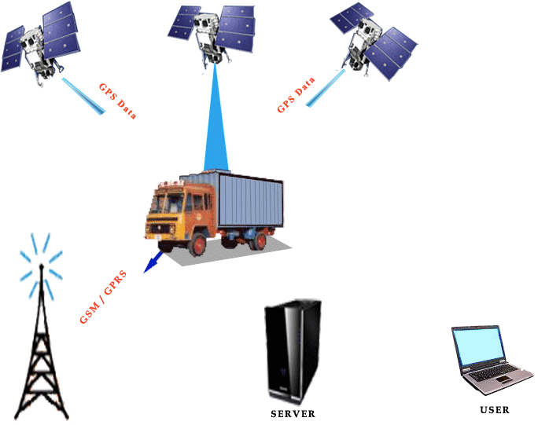
General Packet Radio Service - GPRS
Value added service to 2G to connect users to IP (Internet Protocol) -based data networks.
GPRS offers for data speeds of 14.4 Kbps to 171.2 Kbps, which allow for Internet access.
For example, e-mail and web browsing
It is not the replacement of GSM but an extension of it.

Slide 90
GPRS Key Features
There are 3 key features as follows:
The always online feature - Removes the dial-up process, making applications only one click away.
An upgrade to existing systems - Operators do not have to replace their equipment; rather, GPRS is added on top of the existing infrastructure.
An integral part of future 3G systems - GPRS is the packet data core network for 3G systems EDGE and WCDMA.

Slide 91
GPRS Characteristics

Slide 92
GPRS Characteristics
Resource allocation
resources allocated only when data is to be sent/received
Flexible channel allocation
one to eight time slots
available resources shared by active users
up and down link channels reserved separately
Traffic characteristics suitable for GPRS
Intermittent, burst data transmissions
Frequent transmissions of small volumes of data
Infrequent transmission of larger volumes of data

Slide 93
GPRS Architecture

Slide 94
GPRS Network Architecture
GPRS uses the GSM architecture for voice.
To offer packet data services through GPRS, a new class of network nodes called GPRS support nodes (GSN).
GSNs are responsible for the delivery and routing of data packets between the mobile stations and the external packet data networks (PDN).
GPRS Support Node
Serving GSN SGSN
Gateway GSN GGSN

Slide 95
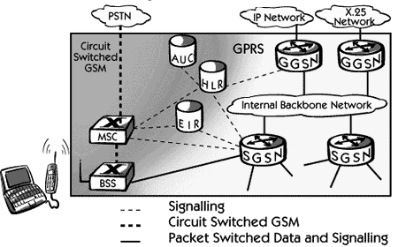
GPRS Network Architecture
GPRS architecture works on the same procedure like GSM network, but, has additional entities that allow packet data transmission.
This data network overlaps a second-generation GSM network providing packet data transport at the rates from 9.6 to 171 kbps. Along with the packet data transport the GSM network accommodates multiple users to share the same air interface resources concurrently.
Notes:
X. 25 is a Telecommunications Standardization Sector (ITU-T) recommendation that defines the physical level (physical layer), link level (data link layer), and packet level (network layer) of the open systems interconnection (OSI) reference model.

Slide 96
GPRS Network Architecture
GPRS attempts to reuse the existing GSM network elements as much as possible, but to effectively build a packet-based mobile cellular network, some new network elements, interfaces, and protocols for handling packet traffic are required.
Therefore, GPRS requires modifications to numerous GSM network elements as summarized below:

Slide 97
GPRS Network Architecture
GPRS attempts to reuse the existing GSM network elements as much as possible, but to effectively build a packet-based mobile cellular network, some new network elements, interfaces, and protocols for handling packet traffic are required.
Therefore, GPRS requires modifications to numerous GSM network elements as summarized below:

Slide 98
GPRS Network Architecture
GSM Network Element | Modification or Upgrade Required for GPRS.
Mobile Station (MS) | New Mobile Station is required to access GPRS services. These new terminals will be backward compatible with GSM for voice calls.
BTS | A software upgrade is required in the existing Base Transceiver Station(BTS).
BSC | The Base Station Controller (BSC) requires a software upgrade and the installation of new hardware called the packet control unit (PCU). The PCU directs the data traffic to the GPRS network and can be a separate hardware element associated with the BSC.
GPRS Support Nodes (GSNs) | The deployment of GPRS requires the installation of new core network elements called the serving GPRS support node (SGSN) and gateway GPRS support node (GGSN).
Databases (HLR, VLR, etc.) | All the databases involved in the network will require software upgrades to handle the new call models and functions introduced by GPRS.

Slide 99
GPRS Network Architecture
GPRS Mobile Stations
New Mobile Stations (MS) are required to use GPRS services because existing GSM phones do not handle the enhanced air interface or packet data.
A variety of MS can exist, including a high-speed version of current phones to support high-speed data access, a new PDA device with an embedded GSM phone, and PC cards for laptop computers.
These mobile stations are backward compatible for making voice calls using GSM.

Slide 100
GPRS Network Architecture
GPRS Base Station Subsystem
Each BSC requires the installation of one or more Packet Control Units (PCUs) and a software upgrade. The PCU provides a physical and logical data interface to the Base Station Subsystem (BSS) for packet data traffic. The BTS can also require a software upgrade but typically does not require hardware enhancements.
When either voice or data traffic is originated at the subscriber mobile, it is transported over the air interface to the BTS, and from the BTS to the BSC in the same way as a standard GSM call.
However, at the output of the BSC, the traffic is separated; voice is sent to the Mobile Switching Center (MSC) per standard GSM, and data is sent to a new device called the SGSN via the PCU over a Frame Relay interface.

Slide 101
GPRS Network Architecture
GPRS Support Nodes
Following two new components, called Gateway GPRS Support Nodes (GSNs) and, Serving GPRS Support Node (SGSN) are added:
Gateway GPRS Support Node (GGSN)
The Gateway GPRS Support Node acts as an interface and a router to external networks. It contains routing information for GPRS mobiles, which is used to tunnel packets through the IP based internal backbone to the correct Serving GPRS Support Node.
The GGSN also collects charging information connected to the use of the external data networks and can act as a packet filter for incoming traffic.
Serving GPRS Support Node (SGSN)
The Serving GPRS Support Node is responsible for authentication of GPRS mobiles, registration of mobiles in the network, mobility management, and collecting information on charging for the use of the air interface.
.

Slide 102
GPRS Network Architecture
Internal Backbone
The internal backbone is an IP based network used to carry packets between different GSNs. Tunnelling is used between SGSNs and GGSNs, so the internal backbone does not need any information about domains outside the GPRS network. Signalling from a GSN to a MSC, HLR or EIR is done using SS7.
Routing Area
GPRS introduces the concept of a Routing Area. This concept is similar to Location Area in GSM, except that it generally contains fewer cells. Because routing areas are smaller than location areas, less radio resources are used While broadcasting a page message.

Slide 103
GPRS Architecture-In Details
GGSN
Other GPRS PLMN
SMS-GMSC
SMS-IWMSC
BSC
BTS
GGSN
Internet/
ISDN/PDN
MSC
SGSN
VLR
BSC
BTS
HLR
AUC
BTS
EIR

Slide 104
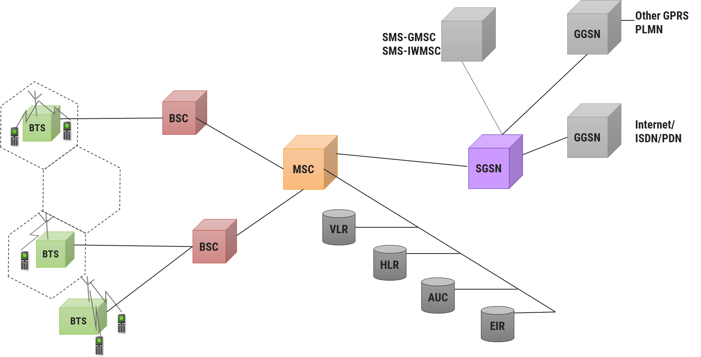
GPRS Architecture
GPRS architecture works on the same procedure like GSM network, but, has additional entities that allow packet data transmission.
Together with the packet data transport the GSM network accommodates multiple users to share the same resources simultaneously.
GPRS reuse the existing GSM network.
Moreover, to effectively build a packet-based mobile cellular network, some new network elements, interfaces, and protocols for handling packet traffic are required.

Slide 105
GPRS Architecture: SGSN
Serving GPRS Support Node
SGSN is at the same hierarchical level as the MSC, so whatever MSC does for voice, SGSN does for packet data.
SGSN’s tasks includes:
Packet switching
Routing and transfer
Mobility management
Logical link management
Authentication and Charging functions
SGSN processes the registration of new mobile subscribers and keeps a record of their location within a given service area.
Location register of the SGSN stores location information (like a current cell, current VLR, etc.) and user profiles of all GPRS users registered with this SGSN.
SGSN sends queries to HLR to obtain profile data of GPRS subscribers.

Slide 106
GPRS Architecture: GGSN
Gateway GPRS Support Node
GGSN acts as an interface between the GPRS backbone network and the external packet data networks.
GGSN’s functions are similar to the router in a Network.
GGSN maintains routing information that is necessary to tunnel the Protocol Data Units (PDUs) to the SGSNs that service particular mobile stations.

Slide 107
GPRS Architecture: GGSN
GGSNs converts the GPRS packets coming from the SGSN into the appropriate packet data protocol (PDP) format for the data networks like the Internet.
PDP sends these packets out on the corresponding packet data network.
PDP receives incoming data packets from data networks and converts them to the GSM address of the destination user.
GGSN stores the current SGSN address of the user and user’s profile in its location register while performing authentication and charging functions related to data transfer.

Slide 108
GPRS Architecture: GPRS Network Enhancement
Base Station System (BSS) needs enhancement to recognize and send packet data.
BTS needs an upgrade to allow transportation of user data to the SGSN.
Also BTS needs to be upgraded to support packet data transportation between BTS and MS over the radio.
HLR needs enhancement to register GPRS user profiles and respond to queries originating from GSNs regarding these profiles.
MS (mobile station) for GPRS is different from that of GSM.
SMS-GMSCs and SMS-IWMSCs(Internetworking MSC) are upgraded to support SMS transmission via the SGSN.

Slide 109
GPRS Architecture: Internal Backbone
The internal backbone is an IP based network used to carry packets between different GSNs.
Tunnelling is used between SGSNs and GGSNs, so the internal backbone does not need any information about domains outside the GPRS network.
Signalling from a GSN to a MSC, HLR or EIR is done using SS7.

Slide 110
Security in GPRS

Slide 111
Security in GPRS
GPRS security is similar to the existing GSM security.
SGSN performs authentication and cipher setting procedures based on the same algorithms, keys and other criteria of GSM.
GPRS uses a ciphering algorithm optimized for packet data transmission.

Slide 112
Routing in GPRS

Slide 113
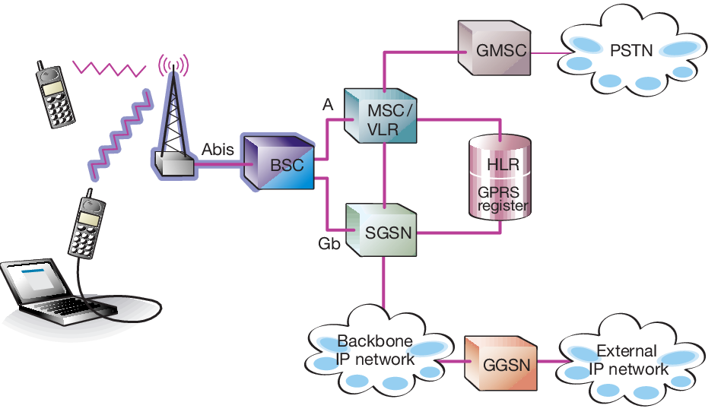
Routing in GPRS
Data routing or routing of data packets to and from a mobile user, is one of the pivot requisites in the GPRS network.
The requirement can be divided into two areas:
Data packet routing
Mobility management

Slide 114
Routing in GPRS
The important roles of GGSN involve synergy with the external data network.
The GGSN updates the location directory using routing information supplied by the SGSNs about the location of an MS.
GGSN routes the external data network protocol packet encapsulated over the GPRS backbone to the SGSN currently serving the MS.
It also de-encapsulates and forwards external data network packets to the appropriate data network and collects charging data that is forwarded to a charging gateway (CG).

Slide 115
Routing in GPRS
PLMN-1
PLMN-2
BSC
BSC
BTS
BTS
Inter-PLMN GPRS backbone
SGSN
SGSN
Intra-PLMN GPRS backbone
Intra-PLMN GPRS backbone
Router Gateway
Router Gateway
SGSN
GGSN
GGSN
LAN
Origin Server
Packet Data Networks(PDN)
router
SGSN that the MS is registered with encapsulates the IP packets coming from the MS, examines the PDP context and routes them through the intra-PLMN GPRS backbone to the appropriate GGSN.
GGSN de-encapsulates the packets and sends them out on the IP network, where IP routing mechanisms are used to transfer the packets to the access router of the destination network.
GPRS MS located in PLMN1 sends IP packets to a host connected to the IP network (e.g. to a Web server connected to the Internet).
An IP address has been assigned to MS by the GGSN of PLMN2 and so, MS’s IP address has the same network prefix as the IP address of the GGSN in PLMN2.
Correspondent host is now sending IP packets to the MS onto the IP network and are routed to the GGSN of PLMN2 (the home-GGSN of the MS).
The latter queries the HLR and obtains the information that the MS is currently located in PLMN1.
It encapsulates the incoming IP packets and tunnels them through the inter-PLMN GPRS backbone to the appropriate SGSN in PLMN1 while the SGSN de-encapsulates the packets.
Home-PLMN of the mobile station is PLMN2.
Finally, delivers IP packets to the host.
Finally delivers them to the MS.

Slide 116
Data Services in GPRS

Slide 117
Data Services in GPRS
Any user is likely to use either of the two modes of the GPRS network:
Application mode
Tunneling mode
In application mode, the user uses the GPRS to access the applications running on the phone itself.
The phone here acts as the end user device.
In tunneling mode, user uses GPRS interface as an access to the network as the end user device would be a large device like laptop computer or a small device like PDA.
The mobile phone will be connected to the device and used as a modem to access the wireless data network.

Slide 118
Bearers in GPRS
Bearer services of GPRS offer end-to-end packet switched data transfer.
GPRS supports two different kinds of data transport services:
Point-to-point (PTP) services
Point-to-multipoint (PTM) services
GPRS continues to supports bearer services. (Same as the GSM)
Wireless Application Protocol is a data bearer service over HTTP protocol.
GPRS supports Multimedia Messaging Service.

Slide 119
Application of GPRS

Slide 120
Application in GPRS
Communications - E-mail, Chat, fax and intranet/internet access, etc.
Value-added services - Information services and games, etc.
E-commerce - Retail, ticket purchasing, banking and financial trading, etc.
Location-based applications - Navigation, traffic conditions, airline/rail schedules and location finder, etc.
Vertical applications - Freight delivery and fleet management.
Advertising - Advertising may be location sensitive. For example, a user entering a mall can receive advertisements specific to the stores in that mall.

Slide 121
Benefits & Limitation of GPRS

Slide 122
Benefits of GPRS
Resources are reserved only when needed and charged accordingly
Connection setup times are reduced
GPRS reuses existing GSM infrastructure, therefore deployment is easier
Enables new service opportunities
It provides seamless and instant connectivity with the internet
Allows simultaneous use of both voice and data services. Thus user can have both voice call and data call together. Data call refers to use of internet by browsing or downloading or uploading data.

Slide 123
Limitation of GPRS
Limited Cell Capacity for All Users:
Only limited radio resources can be deployed for different uses. Both Voice and GPRS calls use the same network resources.
Network can be affected when more number of GPRS users in the same area utilize the GPRS services at the same time. This leads to congestion which results into slower data connection.
Low Speed in Reality:
Achieving the theoretical maximum GPRS data transmission speed of 172.2 kbps would require a single user taking over all eight time slots without any error protection.
GPRS is slower compare to latest wireless standards such as HSPA, LTE, LTE-advanced etc.

Slide 124
Billing & Charging

Slide 125
Billing & Charging in GPRS
Minimum charging information that must be collected are:
Usage of radio interface.
Usage of external Packet Data Networks.
Usage of general GPRS resources and location of the Mobile Station.
Various business models exist for charging customers as billing of services can be based on:
The transmitted data volume
The type of service
GPRS call records generated in the GPRS Service Nodes.
Packet counts passed to a Charging Gateway that generates call detail records that sent to the billing system.

Slide 126
Billing & Charging in GPRS
The SGSN and GGSN register all possible aspects of a GPRS user's behavior and generate billing information accordingly. This information is gathered in so-called Charging Data Records (CDR) and is delivered to a billing gateway.
The GPRS billing parameters:
Volume | The amount of bytes transferred, i.e., downloaded & uploaded both
Duration | Duration of a PDP context session
Time | Date, time of day and day of the week information
Final destination | A subscriber could be charged for access to the specific network.
Location | Current location of the subscriber
Quality of Service | Pay high for higher network priority
Flat rate | A fixed monthly rate
Bearer service | Charging based on different bearer services (for an operator who has several networks, such as GSM900 and GSM1800, and who wants to promote usage of one of the networks).

Slide 127
GPRS Network Operation

Slide 128
GPRS Network Operation: GPRS Protocol Stack
MS
BSS
SGSN
GGSN
Application
Network Layer(IP, X.25)
SNDCP
LLC
RLC
MAC
PLL RFL
Network Layer
GTP
TCP/UDP
IP
Data Link Layer
Physical Layer
Relay
SNDCP | GTP
LLP | TCP/UDP
BSSGP | IP
Network Service | Data Link Layer
Physical Layer | Physical Layer
RLC
Data Link Layer
Physical Layer
BSSGP
Network Service
Physical Layer
Data Link Layer
Relay
Physical Layer
U_{m}
G_{b}
G_{n}
G_{i}
RFL | Radio Frequency Layer
SNDCP | Subnet Dependent Convergence Protocol
PLL | Physical Link Layer
BSSGP | BSS GPRS Application Protocol
MAC | Medium Access Control
GTP | GPRS Tunneling Protocol
RLC | Radio Link Control
LLC | Logical Link Control

Slide 129
GPRS Network Operation: GPRS Protocol Stack
Protocol architecture of the GPRS transmission signaling protocols for control and support of the functions.
It includes:
GPRS attach and detach
PDP(Packet Data Protocol) context activation
Control of routing paths
Allocation of network resources

Slide 130
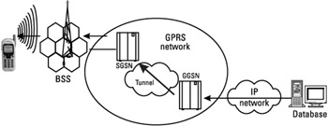
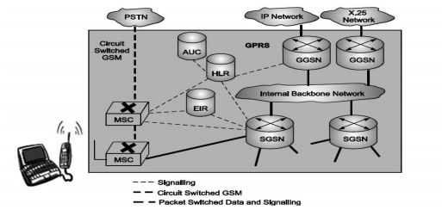
GPRS Network Operation: GPRS Internal Backbone
The internal backbone is an IP based network used to carry packets between different GSNs.
Tunnelling is used between SGSNs and GGSNs, so the internal backbone does not need any information about domains outside the GPRS network.
Signalling from a GSN to a MSC, HLR or EIR is done using SS7.

Slide 131
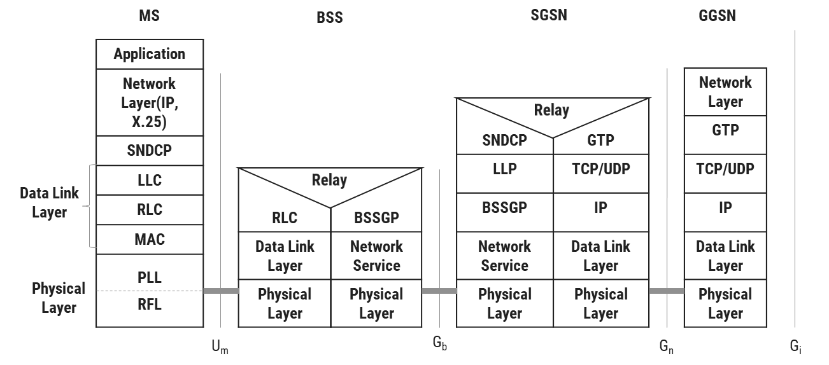
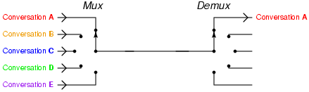
GPRS Network Operation: BSS-SGSN Interface
BSS-SGSN interface is divided into four layers:
Sub-Network Dependent Convergence Protocol (SNDCP) which is used to transfers data packets between SGSN and MS.
Its functionality includes:
Multiplexes several connections of the network layer onto one virtual logical connection of the underlying LLC layer.
Segmentation, compression-decompression of user data.
Logical Link Control (LLC) is a data link layer protocol for GPRS which functions similar to Link Access Procedure-D (LAPD).
This layer assures the reliable transfer of user data across a wireless network.

Slide 132
GPRS Network Operation: BSS-SGSN Interface
Base Station System GPRS Protocol (BSSGP) delivers routing and QoS related information between BSS and SGSN.
Network Service layer manages the convergence sub-layer that operates between BSSGP and Frame Relay.

Slide 133
GPRS Network Operation: Air Interface
Air interface of GPRS consists of data link layer and physical layer.
Data link layer between MS and BSS divided into three sub-layers:
Logical Link Control (LLC) layer
Radio Link Control (RLC) layer
Medium Access Control (MAC) layer
Physical layer between MS and BSS divided into two sub-layers:
Physical Link Layer (PLL)
Physical RF Layer (RFL)

Slide 134
GPRS Network Operation: Logical Link Control (LLC) Layer
This layer provides a reliable logical link between an MS and its assigned SGSN.
Its functionality is based on HDLC (High-Level Data Link Control) protocol.
It includes:
Sequence control
In-order delivery Flow control
Detection of transmission errors and retransmissions
Encryption is used in this interface to ensure data confidentiality.
Variable frame lengths are possible. Both acknowledged and unacknowledged data transmission modes are supported.

Slide 135
GPRS Network Operation: Radio Link Control Layer
Radio Link Control (RLC) layer establishes a reliable link between MS and BSS.
It also does segmentation and reassembly of LLC frames into RLC data blocks and ARQ of uncorrectable data.

Slide 136
GPRS Network Operation: Medium Access Control (MAC) Layer
Medium Access Control (MAC) layer controls the access attempts of an MS on the radio channel shared by several MSs.
It employs algorithms for conflict resolution, multi-user multiplexing on a packet data traffic channel.

Slide 137
GPRS Network Operation: Physical Link Layer (PLL)
Physical Link Layer (PLL) provides services for information transfer over a physical channel between the MS and the network.
Its functions include
data unit framing,
data is encoded before data is transmitted

Slide 138
GPRS Network Operation: Physical RF Layer (RFL)
Physical RF Layer (RFL) performs the modulation of the waveforms based on the sequence of bits received from the Physical Link Layer above.
It also demodulates received wave forms into a sequence of bits that transferred to the Physical Link layer for interpretation.

Slide 139

Thank
You

